Slide 1
Project Report On Shamballa
Develop By.
Sagar Soneji[25260239]

Slide 2
Hospital Accounting Management System
Develpoed by.
Sagar Soneji[25260239]
Guided by.
Mr. Parthik Patel
At
Shree Swaminarayan College of Computer Science
Gurukul Campus, Sardarnagar,BHAVNAGAR
Phone No.(0278)2568222, Fax No.(0278)2568222
(Affiiated to bhavnagar University,Bhavnagar)
E-mail:director@swamigurukul.com,Visit us:www.gurukul.com

Slide 3
CONTENT
INTRODUCTION
MODULES OF SYSTEM
OBJECTIVE
PURPOSE
DIAGRAM
DATA DICTIONARY
SCREEN SHORT

Slide 4
INTRODUCTION
Welcome to Shamballa Dive into our website to discover our peaceful sanctuary. Learn about our mission, explore our facilities, and join our community dedicated to harmony and enlightenment.
Welcome to a place where peace prevails and purpose thrives.

Slide 5
MODULES OF SYSTEM
Home
This module will show website content details..
Donation
This module is for temple donation and fill up temple donation form details.
Temples
This module is display the temple information like darshan time ,history etc.
Shop
This module is purchase a temple related product..
Events
This module is display temples events celebration information..

Slide 6
OBJECTIVE
The main goal of Shamballa is to gather donations for our temple's needs.
Your contributions help us maintain our facilities, support temple activities, and ensure our community thrives.
With your generosity, we can continue spreading spirituality and cultural heritage to all who seek it. Thank you for being a part of our journey towards a better tomorrow.

Slide 7
PURPOSE
The Shamballa Temple website aims to create a comprehensive online platform that caters to the diverse needs of our devotees and visitors.
The project scope encompasses providing essential informationsuch as darshan and aarti timings, offering a glimpse into the rich history of Shamballa, and showcasing the temple's beauty through a vibrant gallery.

Slide 8

DATA FLOW DIAGRAM
Context level Diagram

Slide 9
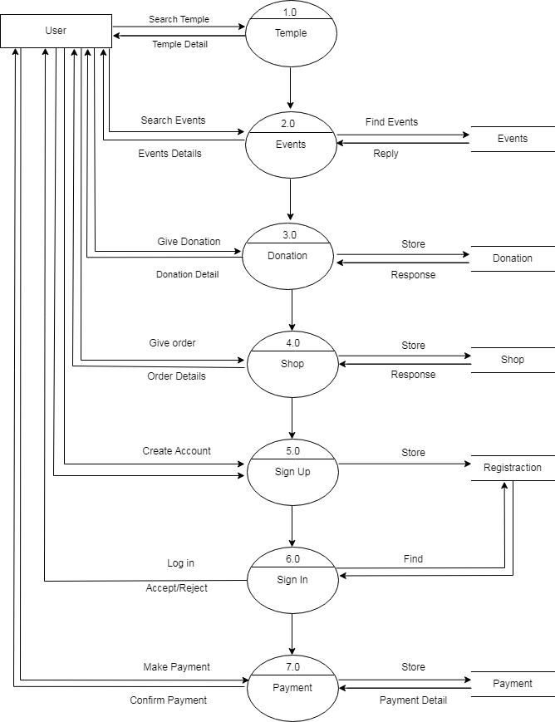
FIRST LEVEL USER DFD

Slide 10
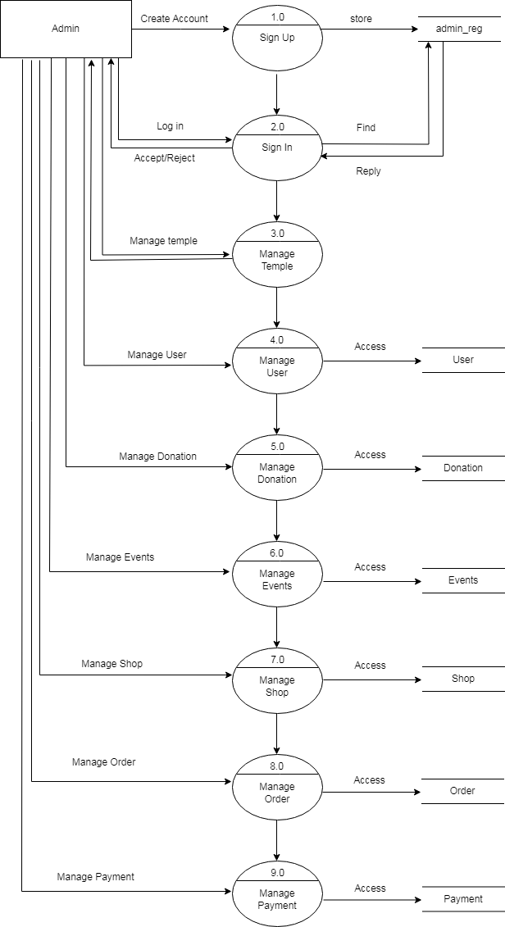
FIRST LEVEL ADMIN DFD

Slide 11
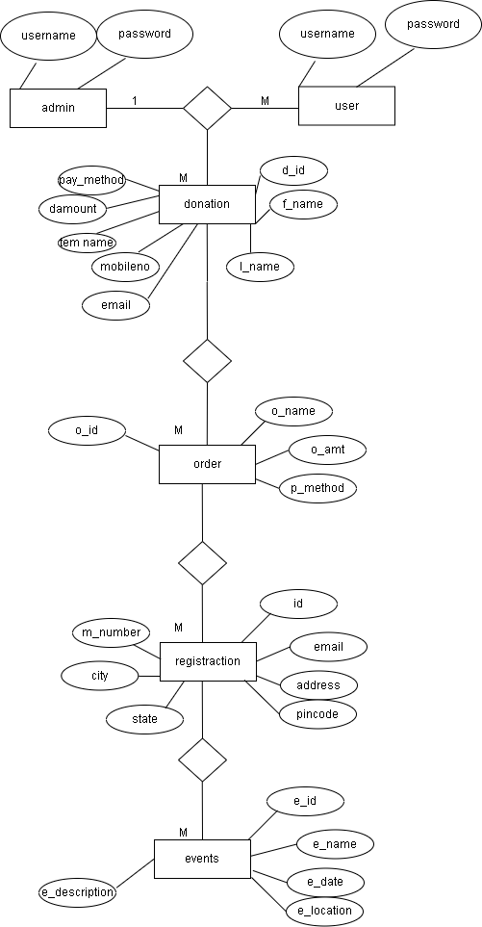
ER DIAGRAM

Slide 12
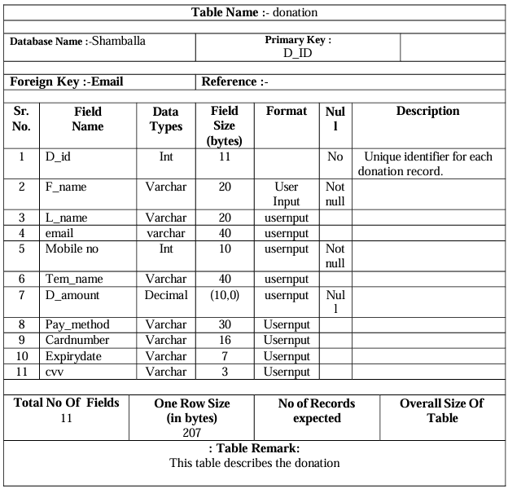
DATA DICTIONARY
Table 1:

Slide 13
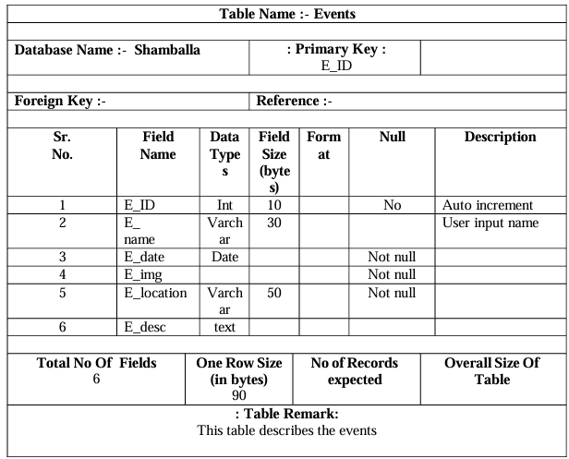
Table 2:

Slide 14
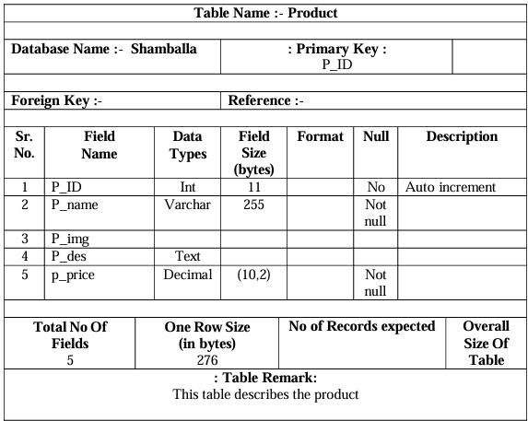
Table 3:
.

Slide 15
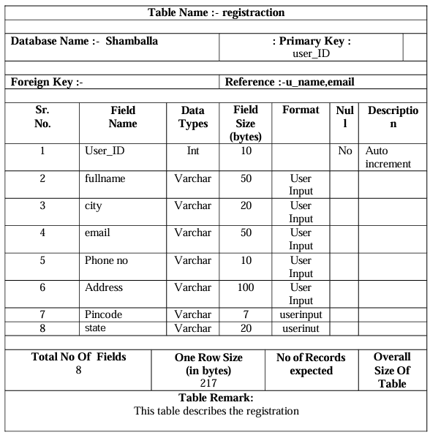
Table 4:

Slide 16
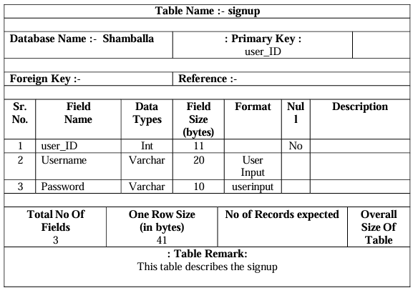
Table 5:

Slide 17
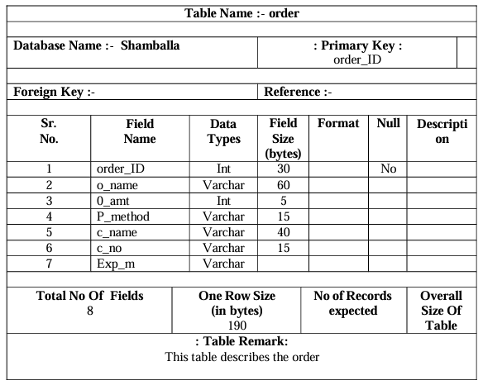
Table 6

Slide 18
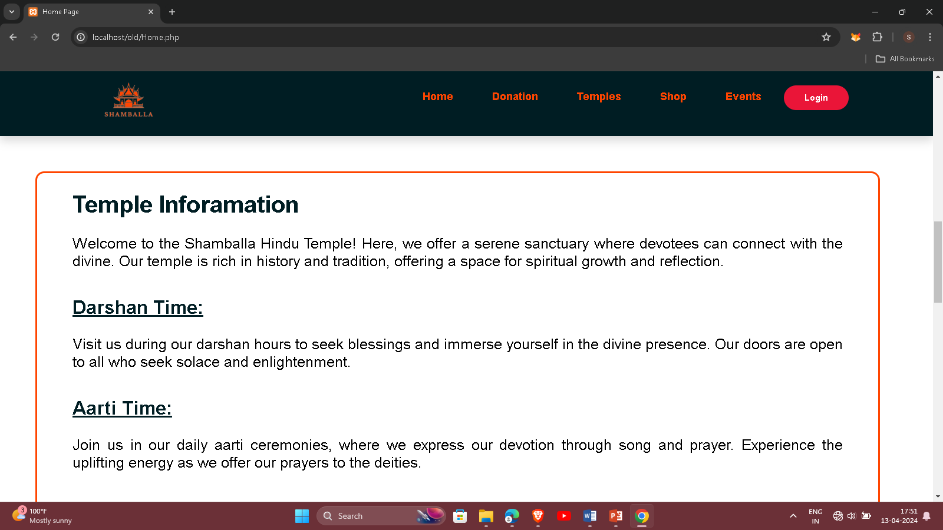
SCREEN SHORT Home page:
Description
This is home page is display our websites sections information.

Slide 19
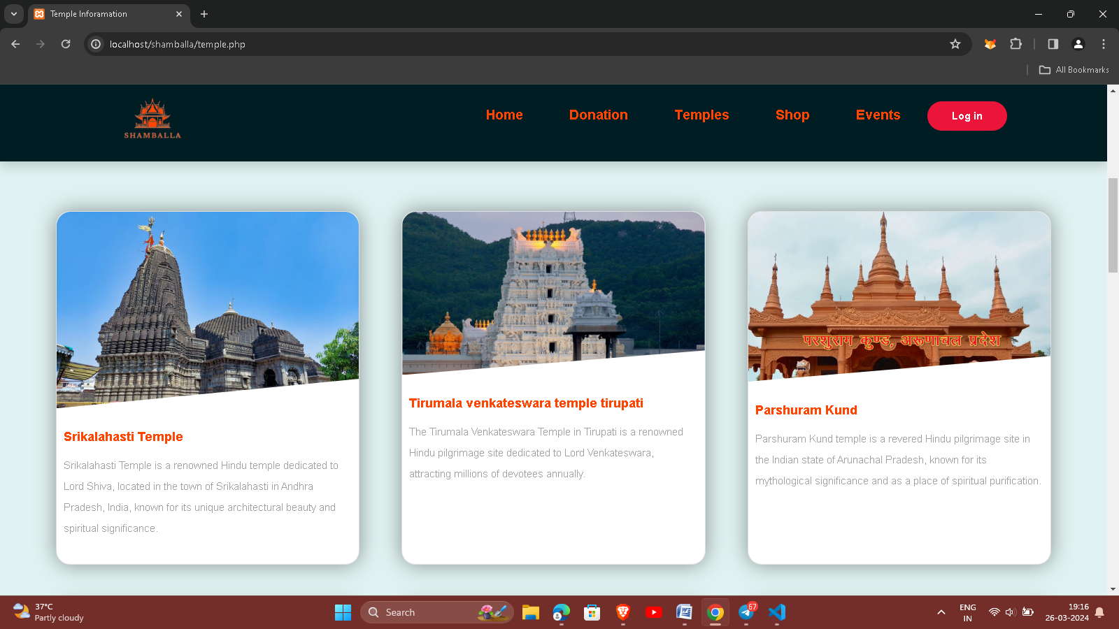
Temple page:
Description
This is temples card name and description and click to display full detail.

Slide 20
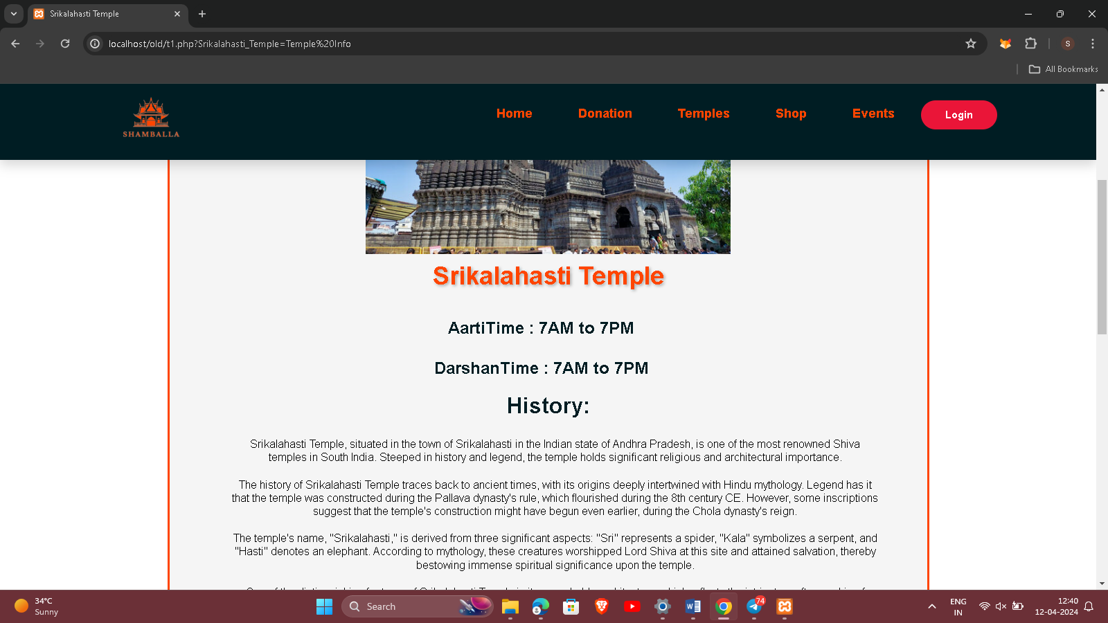
Temples Sub page:
Description
This is temples subpage to display aartitime ,darshan time , history and gallery.

Slide 21
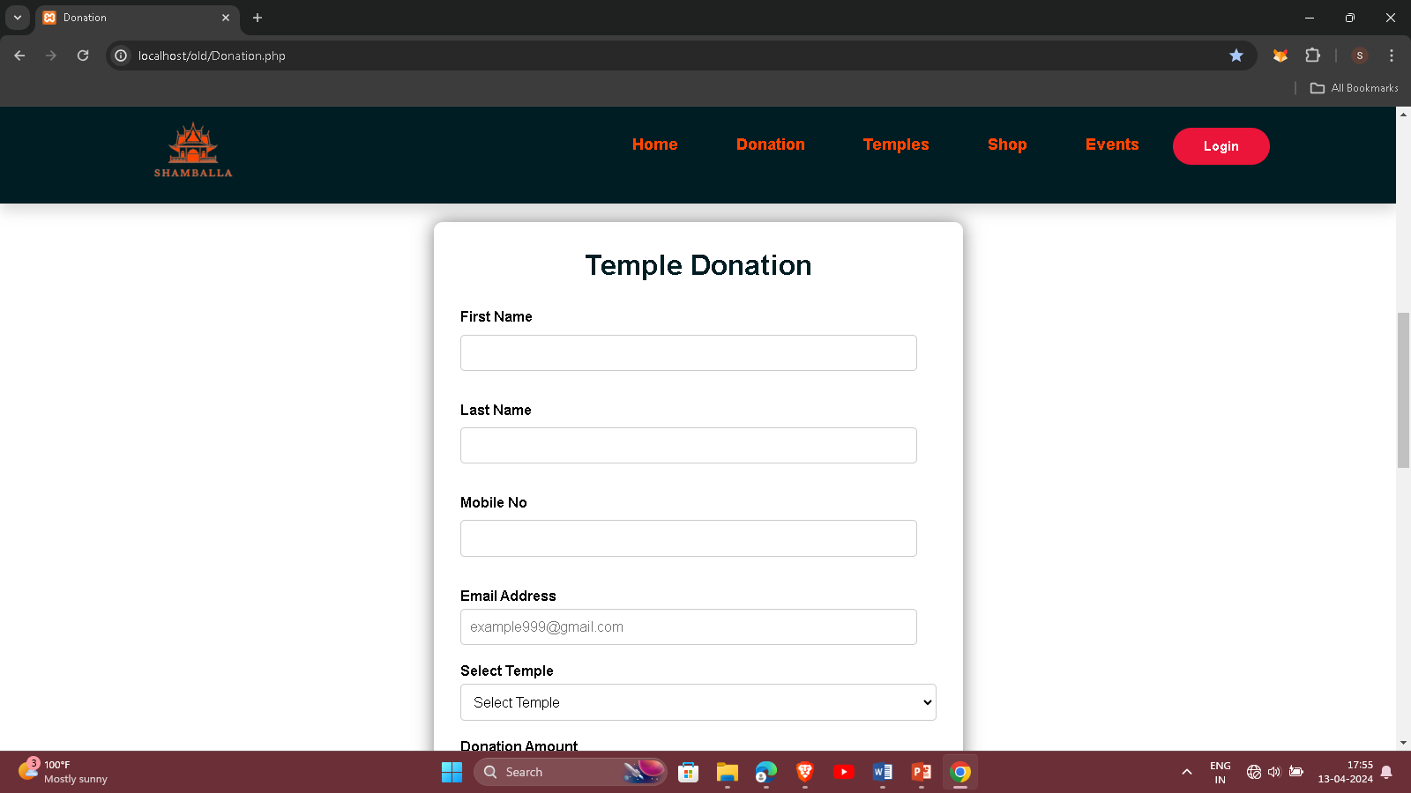
Donation page:
Description
This is donation page to display form of temple donation.

Slide 22
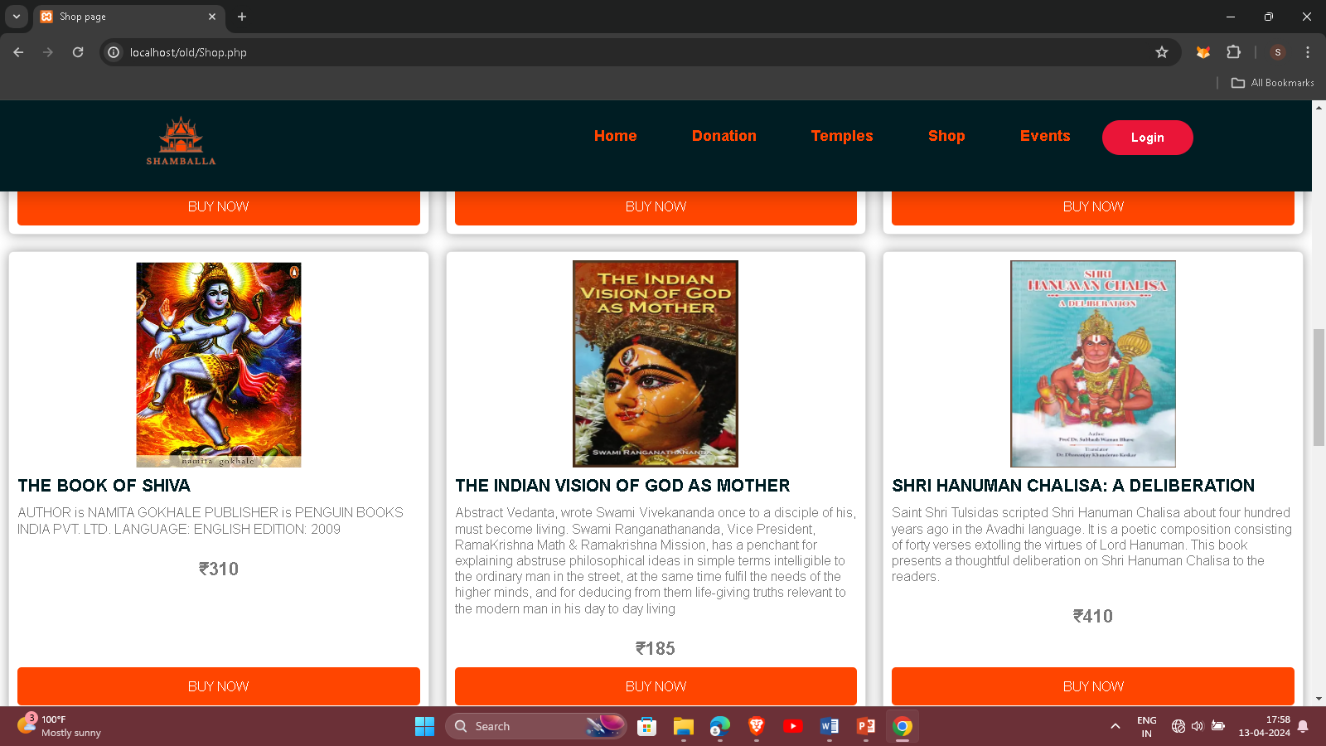
Shop page:
Description
It will display the product cards to purchase product.

Slide 23
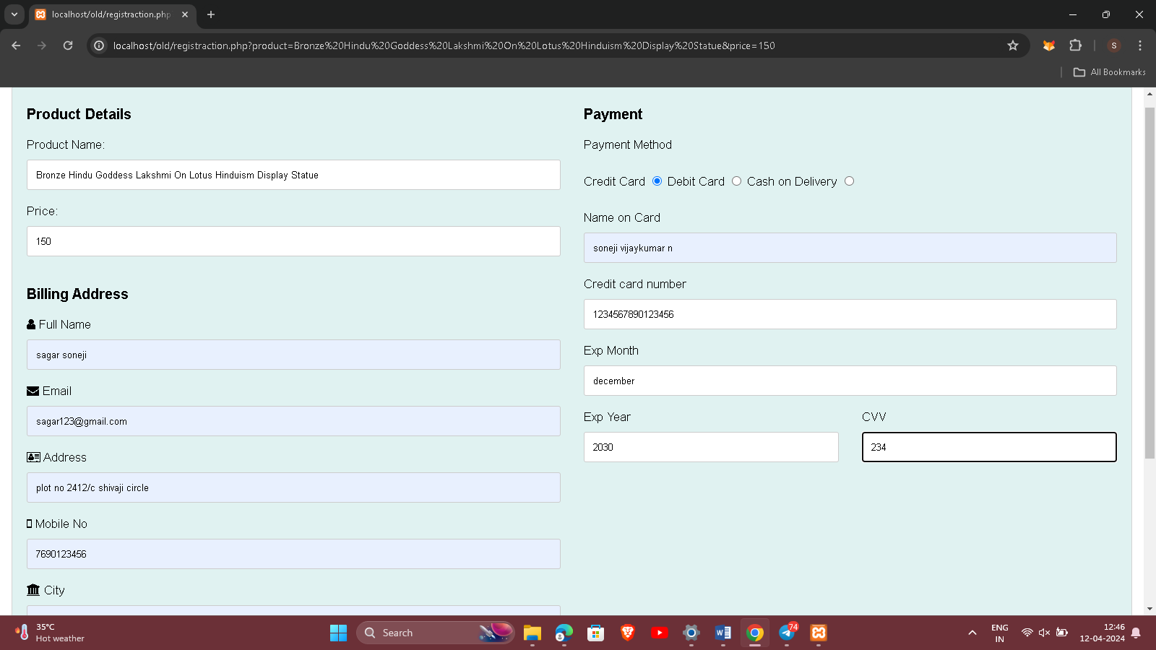
checkout page
Description
This for purchase product to fill this information.

Slide 24
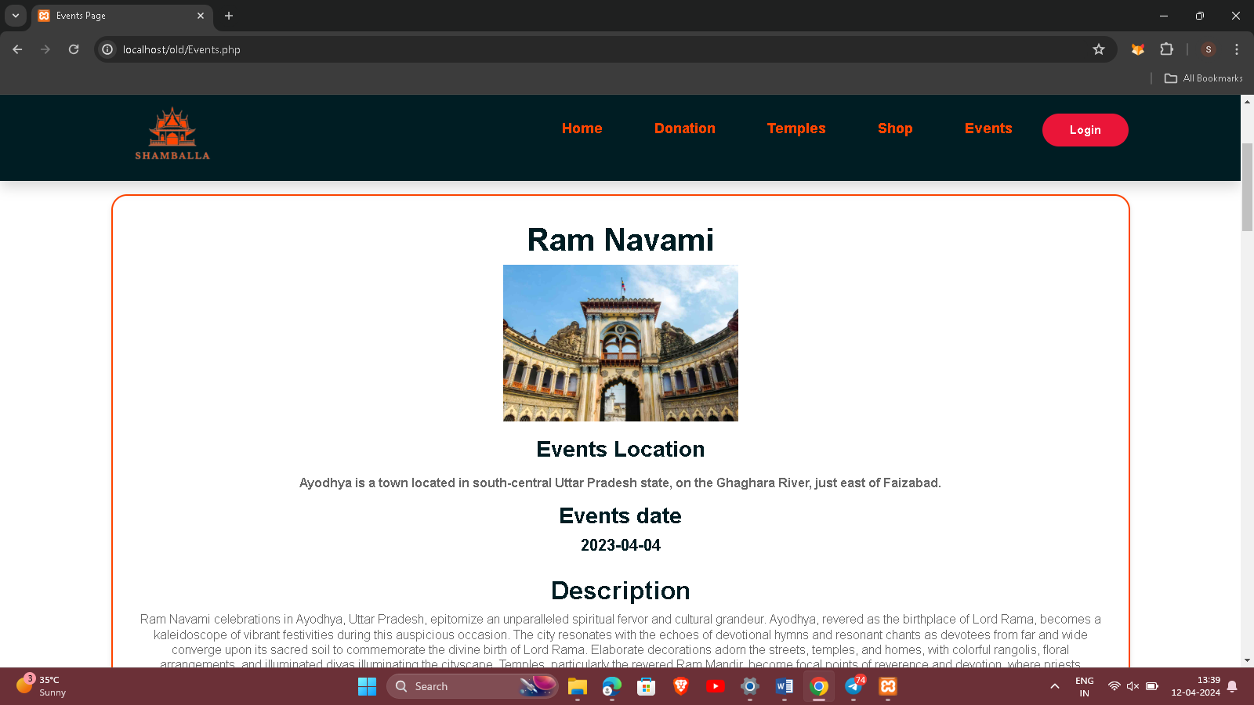
Events:
Description
This is temple events celebrations information like event name , event date, event location and event description.

Slide 25
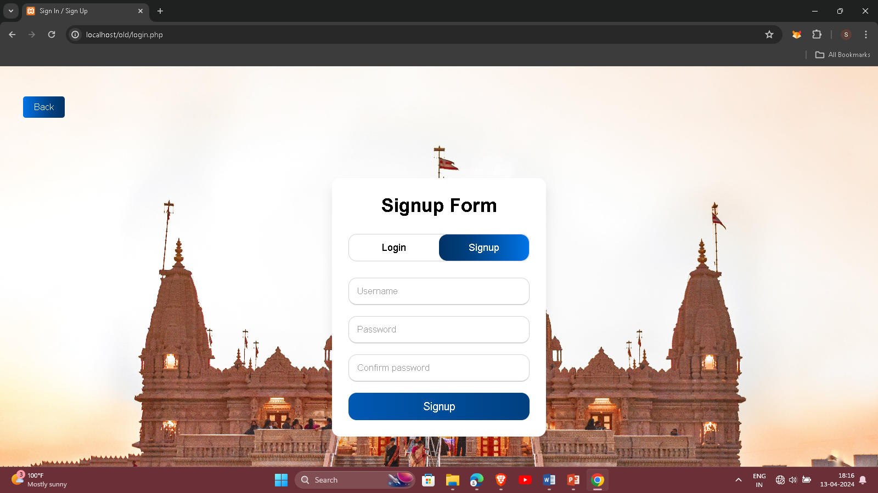
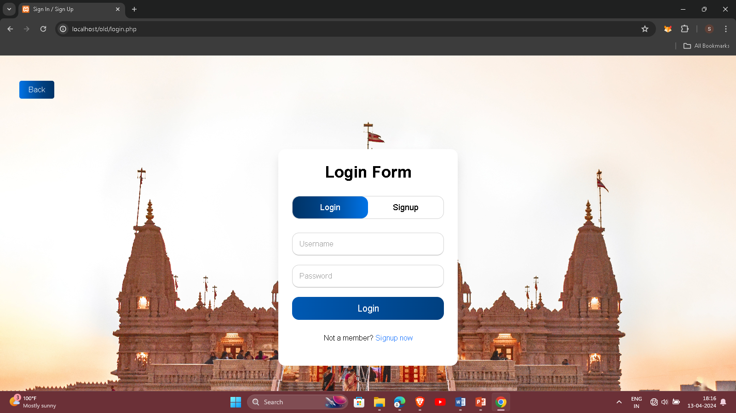
Login and Signup page:
Description
This is user Login and signup page to enter username and password.

Slide 26
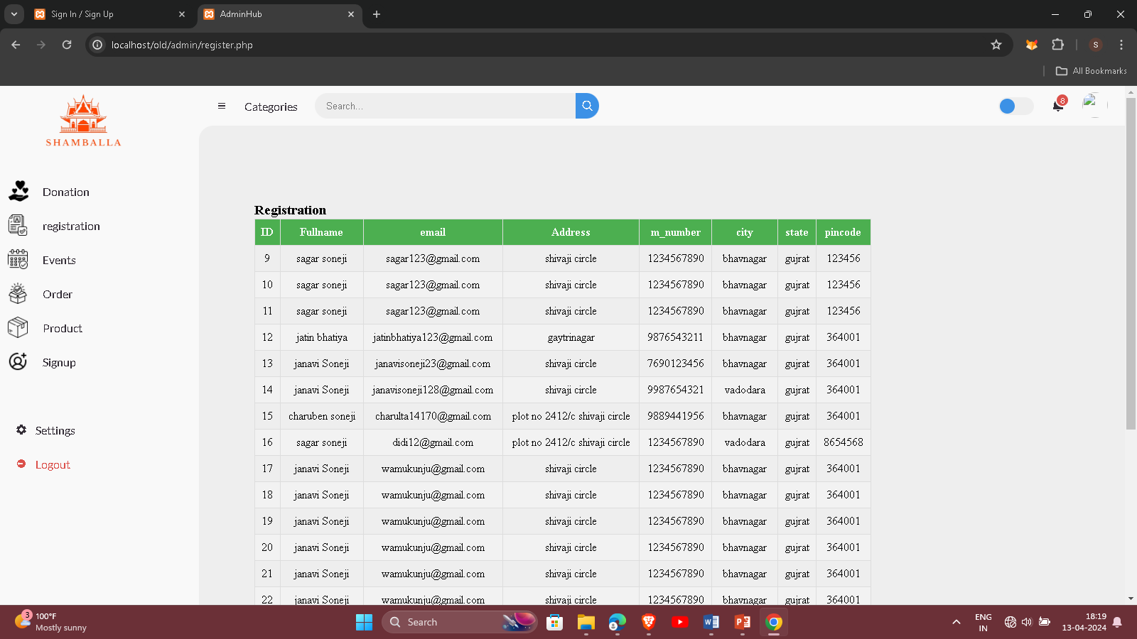
Admin Panel:
Description
This is admin panel to admin manage tables.

Slide 27
Thank You

